Slide 1
Drone Delivery
By Michael R. Badding, Leticia J. Spencer, and Kelsey A. Johnson

Slide 2
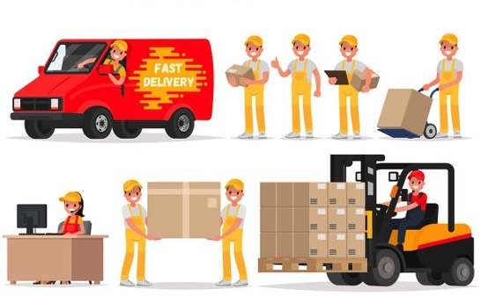
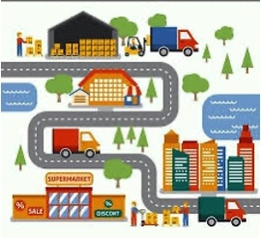

Problem Statement
Human interfaced completion of product delivery can no longer meet the expectations of consumers due to lacking capability.
Human based product delivery systems has many costs, obstacles, human workforce dependency, grid route dependency, and time window delivery issues.
Drones have the capability and potential to completely replace human interfaced product delivery. The problem at hand is how can their operations so different from existing delivery systems be optimized.

Slide 3

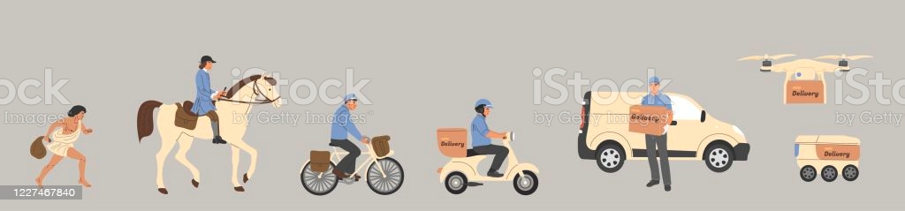
History of the Problem
Delivery, mail and courier services were first introduced by the Persian Empire in the 6th Century BCE.
These systems were not only useful for delivering goods and messages, but farmers discovered the ability to gain higher profits by shipping directly to consumers versus store front sales.
Each improvement of the system from pony to railroad to flight to truck to drone has been to minimize overall cost while increasing the speed of delivery and profit.
The optimization of delivery for a "salesperson" is called a Traveling Salesperson Problem (TSP) originating from 1930s mathematical discussion. Multiple Salespersons for larger operations designed mTSP optimization problems and solutions. Within the recent years the Vehicle Routing Problem (VRP) derivation for complex vehicles has been the problem to solve.

Slide 4
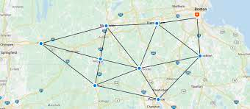
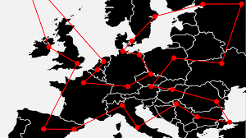
Goals and Considerations
Given a fleet of drones we are tasked with optimizing the delivery of products to customer orders from warehouses in the most efficient time for a specified scenario.
We will consider the weight of products, drone initial starting location, turn-based time requirements, product warehouse availability, and entity coordinates.

Slide 5
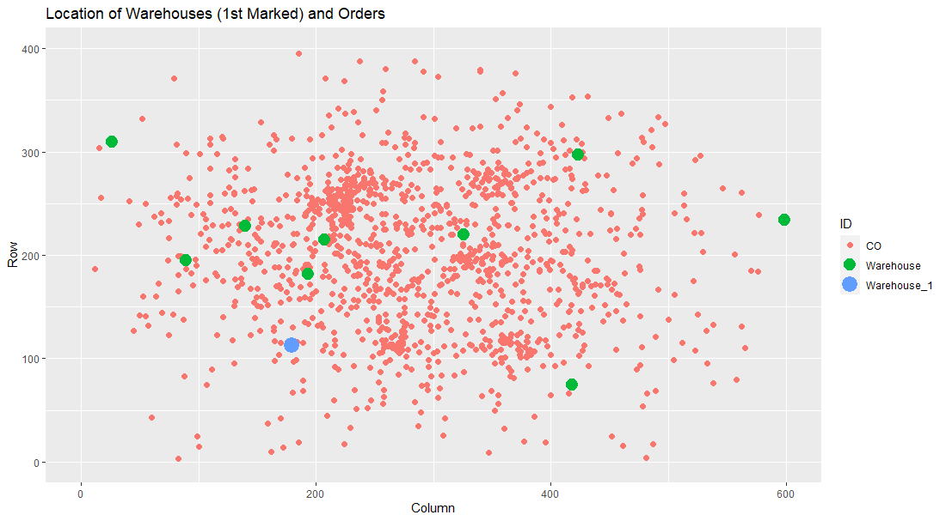
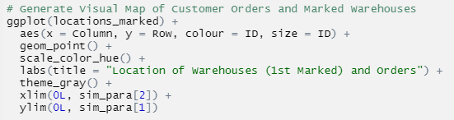
Data Analysis - Locations
Large clusters of orders
Drone starting location in the bottom left and only a few warehouses centrally located in relation to the orders
Edge warehouses will require much more time to deliver products for centrally located orders and vice versa for central warehouses

Slide 6
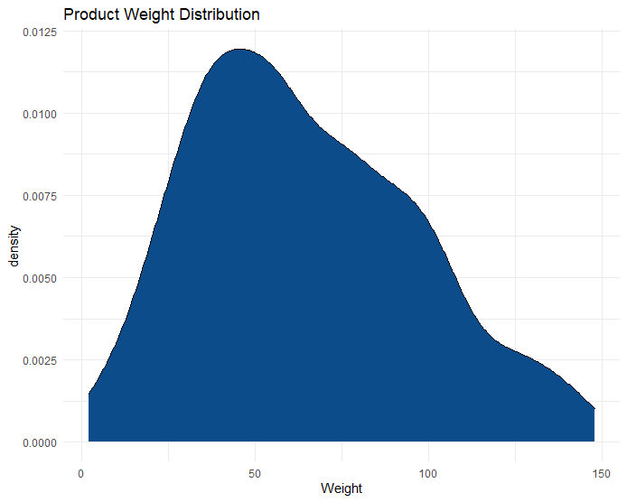

Data Analysis – Product Weights
Max load a drone can handle is 200 units.
Average weight of a product is 65u and median is 60u
Minimum is 2u and the maximum is 148u
A drone can therefore have on average 3 products of the same type loaded. The combinations of products on the other hand are numerous.

Slide 7
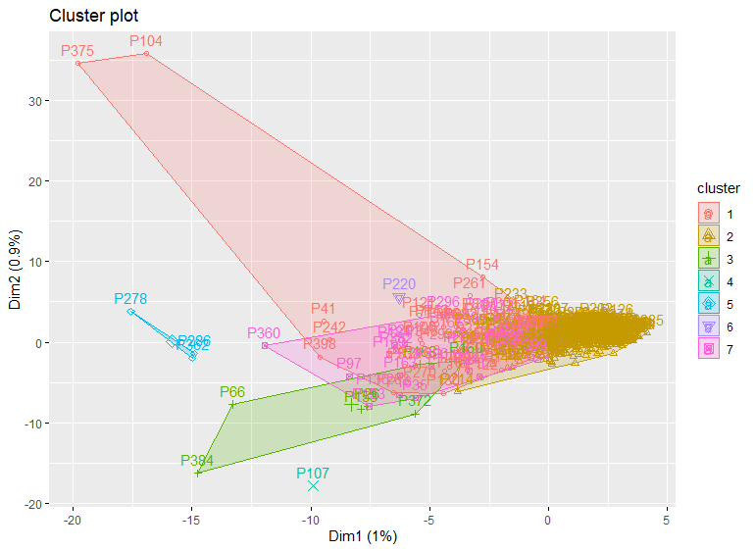

Data Analysis - Clustering
Products have their own identifiable groupings
Useful to consider for shipping products together for multiple orders
When optimizing the route, these clusters can be utilized for designating products to be shipped together efficiently.

Slide 8
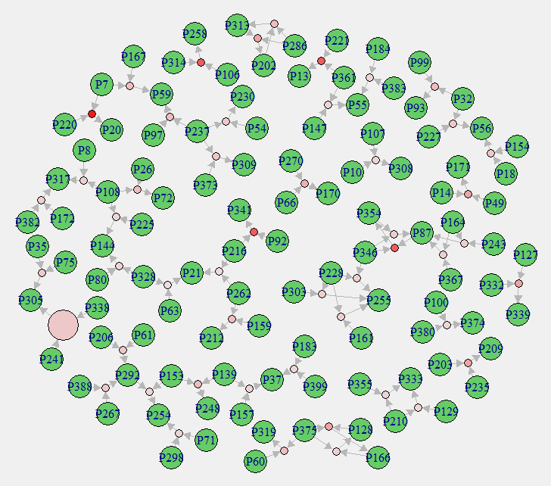
Data Analysis – Association Rule Mining
While based on the clustering the products have obvious groupings there are very few rules that have a large amount of support.
For the given scenario, the consideration of product relationships in the solution for mTSP will likely not result in observable efficiency increases.

Slide 9
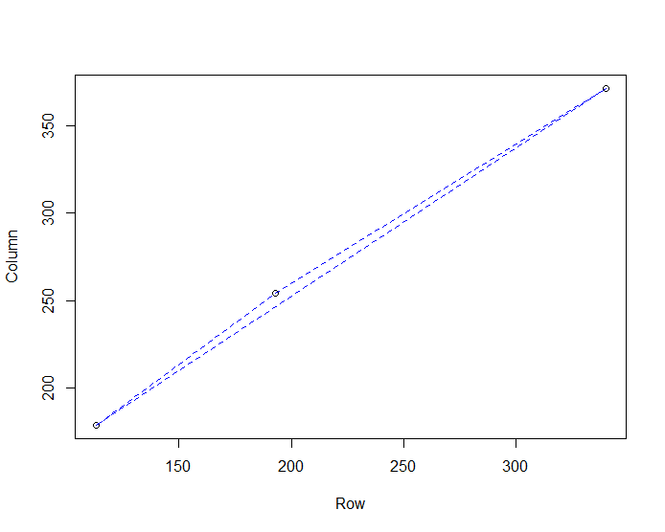
Problem Optimization
To solve any variant of an mTSP such as a VRP the problem must be flattened and divided into multiple basic TSPs.
Essentially each drone is assigned a collection of customer orders and the warehouses to visit to pick up products and this is repeated until all orders are met or the deadline is up.
This collection of locations and commands is then solved via a “Greedy” TSP solver.
Score is calculated to observe differences in the way drones are assigned to customer orders to identify the most optimal solution.

Slide 10
Conclusion
Additional implementation of features for realistic considerations such as drone maintenance, weather conditions, drone differences.
Returns and gains based on reduction of human labor costs, delivery flexibility, avoidance of terrain considerations, delivery distance reduction. An analysis showed that the drone delivery per package would be under 10 cents compared to the $1.20 per package when using UPS truck delivery.
Trailblazers Zipline and Wingcopter have been very successful in Africa and Europe.
Obvious benefits as big companies like Google (Alphabet), Amazon, and UPS are rushing to implement drone delivery systems.

